Slide 1


25-1-R-18
Capstone Project Phase A
Temporal identifying of influential nodes
in complex citation networks
Students: Anna Garmash
Oren Baranovsky
Supervisors: Dr. Renata Avros
Prof. Zeev Volkovich
Notes:
- Hello Everyone | my name | partner |we will introduce our topic:
- Temporal identification of influential nodes in complex citation networks.
- Lets start with an introduction.

Slide 2
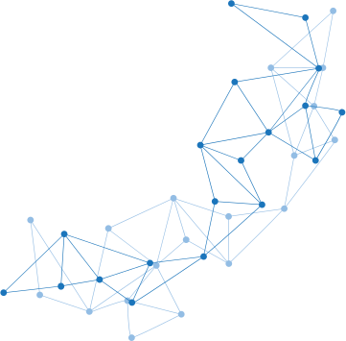
Introduction
The problem – identification of change in documents influence.
Current solution – Centrality Measures
Innovative solution – Gravity Models
Notes:
The problem – identify change | gain interest | loss interes | over time.
Currently The solution ins centrality Measures
Gravity Models | More Accurate | Include info – connectivity force, and distance

Slide 3
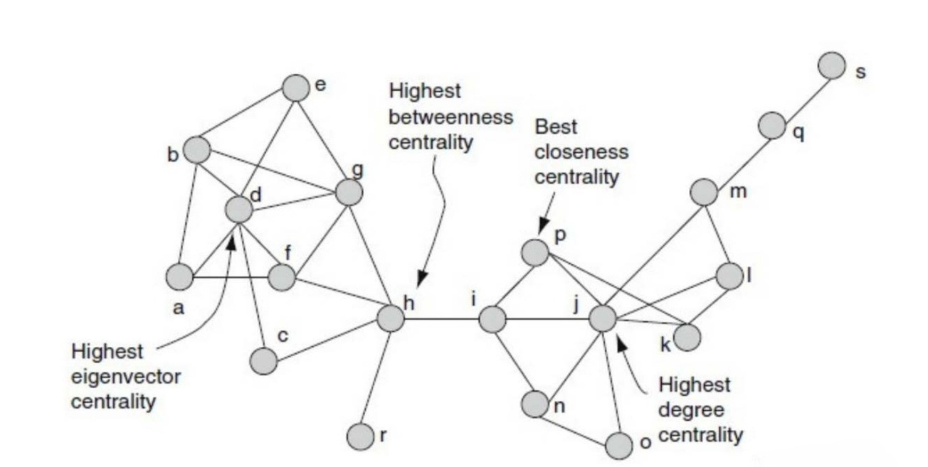
Node Centrality: Background
Node Centrality is ambiguous – There are different definitions for importance which might depend on the data or expected result.
Lets discuss the different types of node centrality.
Notes:
Ambigouses | usecases: data-sets and expected results.
In our project | later section - research process.
For now discuss types |
in this picture |
We will now discuss most of these examples. |

Slide 4
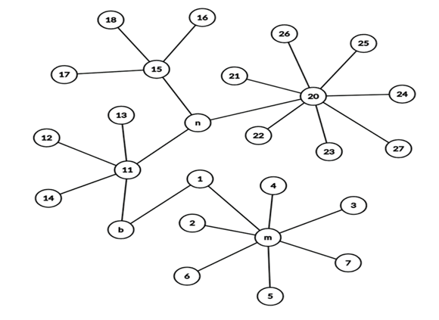
Node Centrality: Degree Centrality
The most trivial (and yet very useful) type of centrality is Degree Centrality, in which the importance score of a node will be its degree. Calculation is preformed by iterating through all the nodes and counting number of neighbors.
Consider nodes n & m in the image on the right, m will get higher score, but is it more important than m?
Notes:
Lets start with Degree Centrality
Considering computation, iterate once
The price we do pay here actualy is loss of information | local for each node |global structural info not considered.
Picture m & n | n connects more to network
This leads us to the next centrality type.

Slide 5
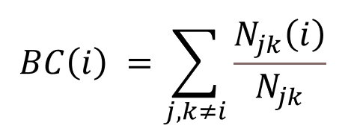
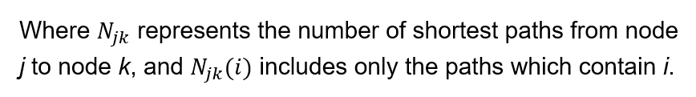
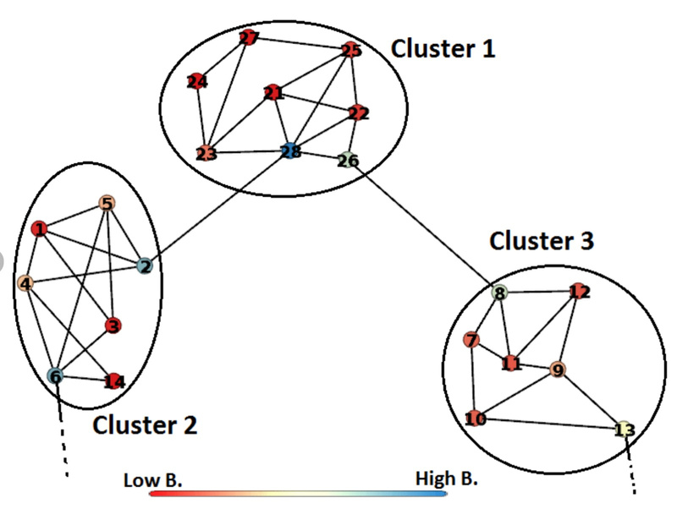
Node Centrality: Betweenness Centrality
Starting with the formula
Computation here is much more intensive compared to degree centrality – lots of shortest path computations are required.
Blue nodes are with higher betweeness centrality.
Notes:
Formula – calculate shortest paths which include I, out of all shortest path between j and k.
Heavy on performance – lots of shortest paths.
betweenness centrality identify the nodes which connects clusters Now lets continue to the third type of centrality, which is eigenvector centrality.

Slide 6



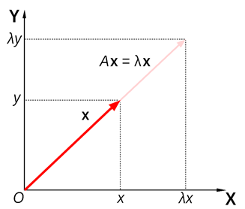
Node Centrality: Eigenvector Centrality
In this type of calculation, the nodes that are connected to other nodes with high importance will get the larger scores – these nodes are called Authoritative Nodes.
Eigenvalues & Eigenvector:
Eigenvalues are scalars which scale a vector without changing its direction the same way a matrix (which is a Linear transformation) does to that vector. We call this vector an Eigenvector.
But why is it true?
At a quick look, it is not clear how Eigenvalues relates to centrality of that sort.
Notes:
Eigenvector Centrality : nodes which are connected to important neighbors.
For individuals not familiar | linear algebra & importanc of neighbors ?
Formula - only neighbors, why j-th elem na dlambda?
Reminding - that eigenvalues are scalars which scale vector | linear transformation (aka a matrix) does
Interested - highest eigenvalue of the adjacency matrix

Slide 7
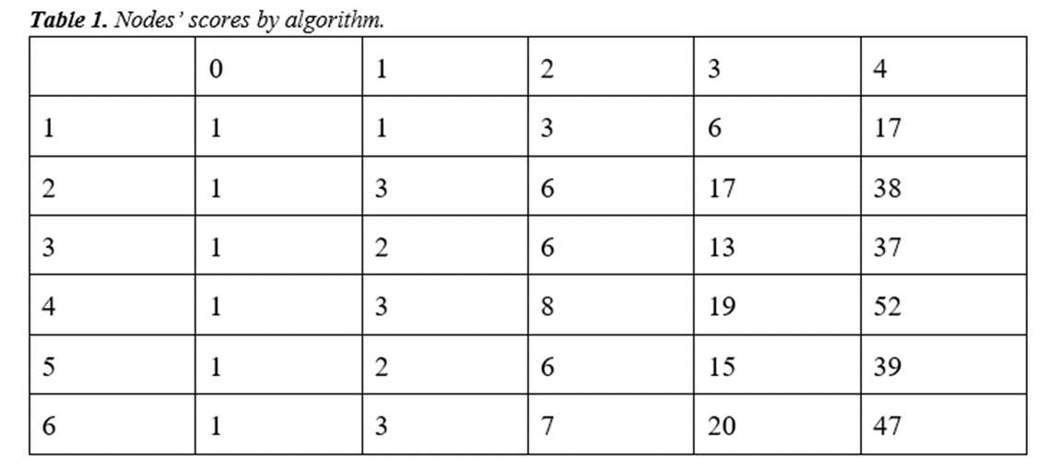
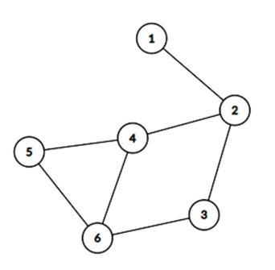
Node Centrality: Eigenvector Centrality
Let us take short look on an algorithm which is measures importance based on importance of neighboring nodes:
1. Initiate all the scores to 1.
2. Execute 4 iterations, for each node: Update score as the sum of neighbor scores.
3. Normalize the scores 0 - 1
Notes:
Throwing light – relationship
Algorithem, surly consider neighbors
First initiate
Then, sum up the scores of their nieghbors | iterate
end - each node has its score.

Slide 8
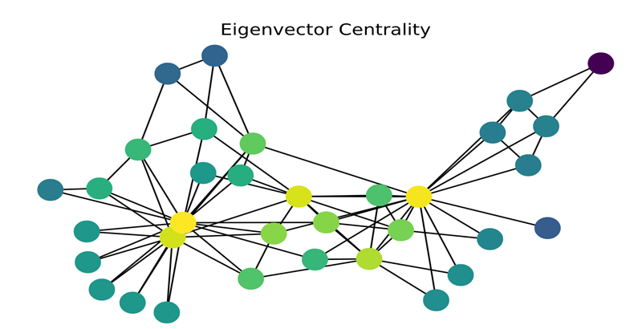
Node Centrality: Eigenvector Centrality
The Eigenvector which corresponds to the highest Eigenvalue of the Adjacency matrix of the given graph is [0.31, 0.79, 0.69, 1.00, 0.78, 0.97].
The normalized vector we received after 4 iteration is : [0.32, 0.73, 0.71, 1.00, 0.75, 0.90].
Using algebraic Spectral decomposition, it could be proven that this algorithm converges to the eigenvector.
Green and yellow nodes are more central and blue nodes are less central.
Notes:
Normalize
here is the eigen vector
eigenvector & result vector - similar.
Proving - converges -using algebraic spectral decomposition.
This is all - Node Centrality -Anna - gravity models.

Slide 9
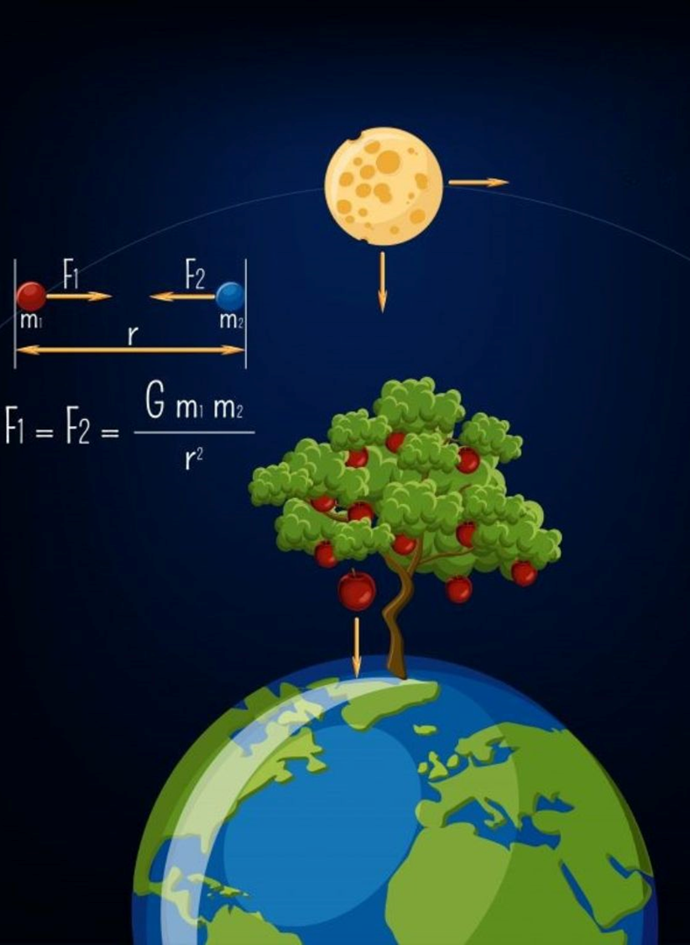
Gravity Models: Background
Inspired by Newton’s law of universal gravitation, where the gravitational force between objects depends on their mass and distance.
Each model redefines “mass”, “distance” and the “gravity coefficient” based on the elements it considers important.
The balance between mass and distance reflects a universal principle of how connections are influenced by size and proximity
Notes:
Gravity models introduce an innovative approach to measure the importance of a node in complex networks. The intuition for these models is inspired by Newton's law of universal gravitation, where the gravitational force between objects depends on their mass and distance. Each model redefines “mass”, “distance” and the “gravity coefficient” based on the elements it considers important.

Slide 10
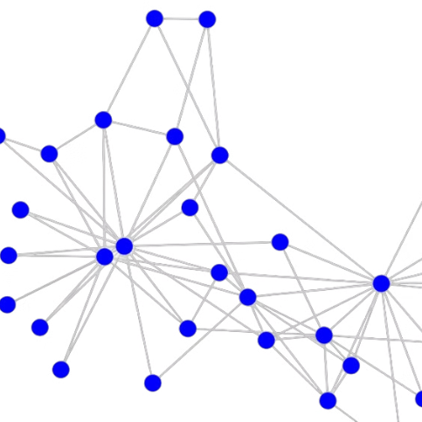
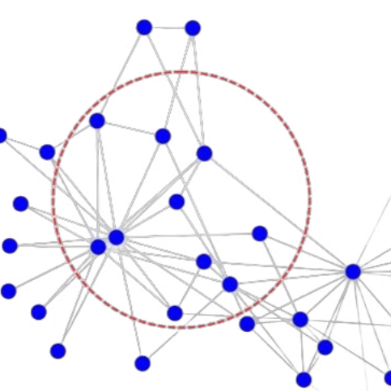
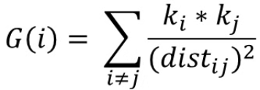
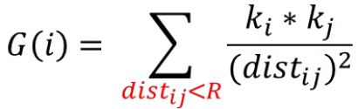
Classic Gravity Model
Local Gravity Model
The mutual attraction between two nodes is inversely proportional to the square of their distance.
R is the truncation radius and is often set to half of the average length of the shortest path.
Notes:
We will start with first two models: Classic Gravity Model and Local Gravity Model.
Lets look at Classic Gravity Model and understand the formula, because we will meet the same principle in the following models.
In this model, k represents the node degree, and dist is the shortest distance between nodes. The influence G of a node i is calculated as the sum of the products of node degrees, divided by the square of the shortest distance between them.
In the Local Gravity Model, the sum is not calculated over the entire network but only for nodes within a truncation radius R. This model tries to find the balance between local and global effect.

Slide 11
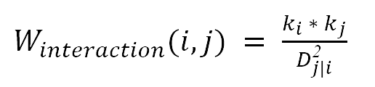
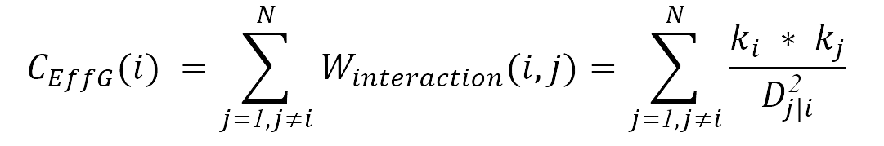
Effective Distance Gravity Model (EFFG)
The model considers the hidden dynamic structure of the network by using probability. It accounts for the likelihood of transitions between nodes.
Effective distance is a distance abstracted from the probability, which uncovers the hidden structure of the network. It was merged into the Gravity Model as the distance between two nodes, replacing the Euclidean distance.
Euclidean distance only focuses on the static distance of the nodes and cannot effectively extract the hidden structure.
Notes:
The next model we will consider is the Effective Distance Gravity Model. Its main goal is also to determine a node's influence score, but instead of using Euclidean distance, it relies on Effective Distance.
Effective Distance is derived from probability, unlike Euclidean distance, which focuses only on static distances and cannot effectively capture the hidden structure of the network. To address this limitation, the model uses probability-based calculation.
Originally, this model was developed for studying epidemic models, where probability helps to reveal the network’s hidden structure.

Slide 12
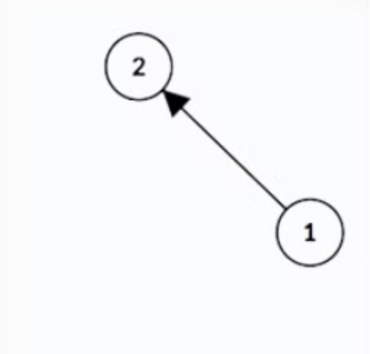
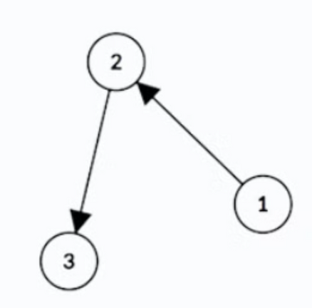

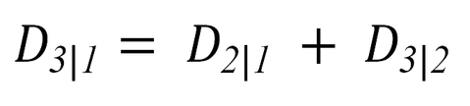
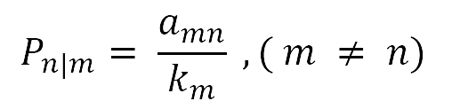
Effective Distance
Directrly connected nodes
Distant nodes
The value of the effective distance and the probability of moving from node m to node n:
The effective distance of nodes that are not directly connected can be obtained transitively.
Where D is the value of effective distance from node m to n if they are directly connected, P is the probability of moving, k is the out-degree of node in directed graph and a is the element in the adjacency matrix of graph.
Notes:
The effective distance from node m to n that are directly connected is calculated using the formula …. Where P is the probability of moving from node m to n.
The probability P can be found by the following way … where a is the adjacency matrix element and k is the out-degree of the node m. (a is 1 if nodes are connected, otherwise 0).
Due to logarithmic transformation to the probabilities,
high-probability edges become shorter distances, while low-probability edges become longer.
For nodes that are not directly connected, the effective distance is calculated transitively by summing the effective distances along the shortest path.

Slide 13
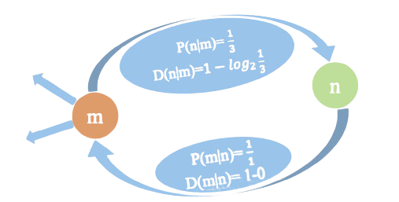

Effective Distance is asymmetric distance
The EffG is well-suited for analyzing directed networks. The flow of information is not necessarily mutual.
Euclidean distance from M to N and from N to M is the same because it is a non-directional distance measurement.
The effective distance is typically asymmetric, meaning that the computed "distance" from node M to node N is not necessarily the same as from N to M.
The effective distance in a directed network accounts for the fact that movement may be with higher probability in one direction than the other.
Notes:
The Effective Distance Gravity Model is well-suited for analyzing directed networks.
The Euclidean distance between the nodes will be the same because it is a non-directional distance measurement.
The effective distance is asymmetric, meaning that the distance from M to N is not the same as from N to M. This asymmetry comes from the differences in transition probabilities in different directions.

Slide 14
Research Process: Introduction
In this project we focus on three types of important nodes:
High Citation Nodes: documents that are cited a lot.
Bridge Nodes: documents that provide connectivity between clusters.
Authoritative Nodes: documents that are cited by other important documents which make them more authoritative.
The idea is to identify these three types of important nodes using different gravity models and track the behavior of the importance scores throughout the timestamps for each of these nodes.
Notes:
During the background | small portion types |as you might guess - choose to omit from this presentation |because focus our network
Our idea focus on 3 relevant for citation.
Our ideas | Gravity Models | in a network growing throughout timestamps.

Slide 15
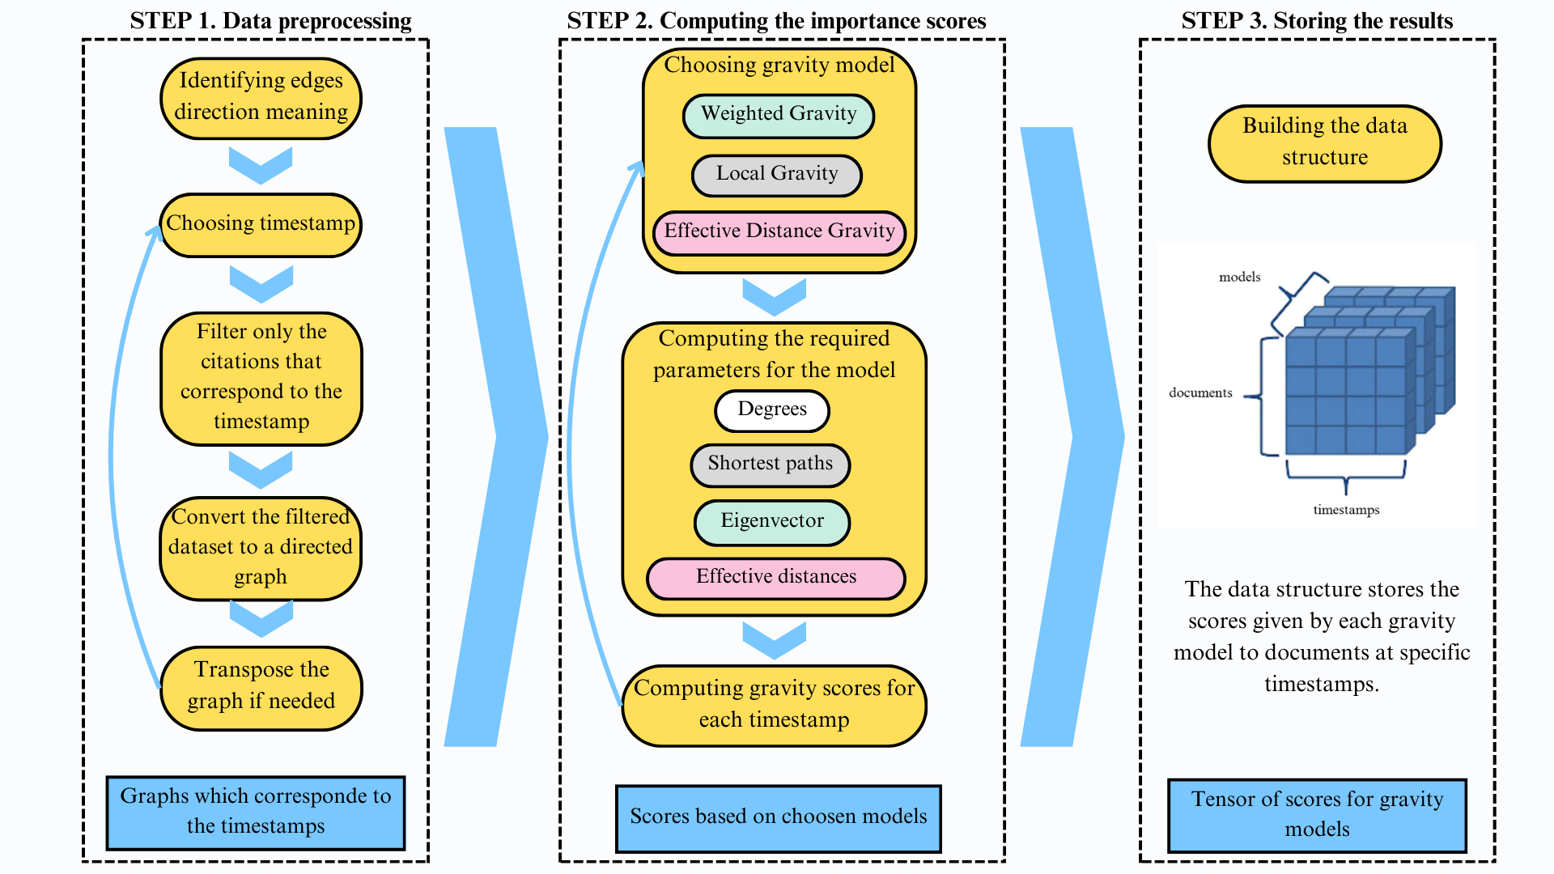
Notes:
Diagram | discuss the process
process devided 3 steps
Preprocess
direction of citation
choose the timestamps | example ninety-eighty
convert data set to directed graph | transpose if to switch direction of citation.
The second step revolves around computing the scores:
choose models.
compute parameters
compute scores
Finaly store the result in 3D array for analysis.

Slide 16
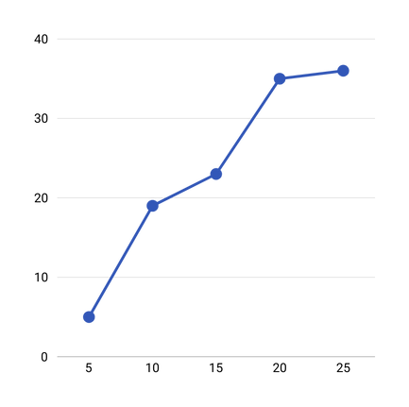
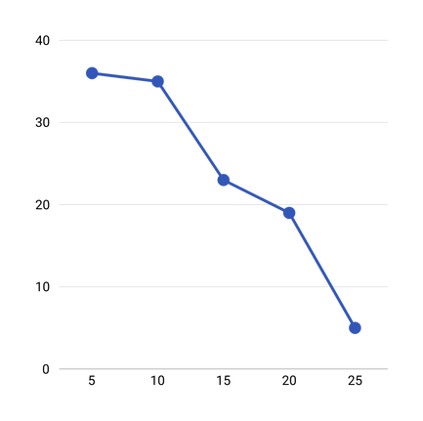
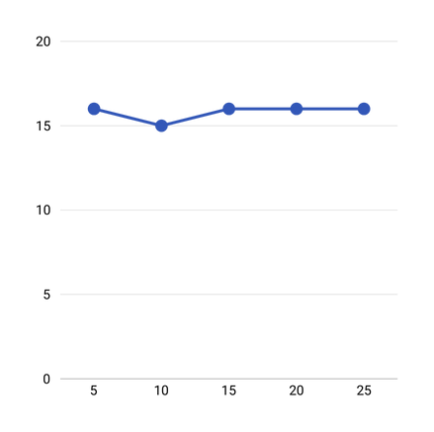
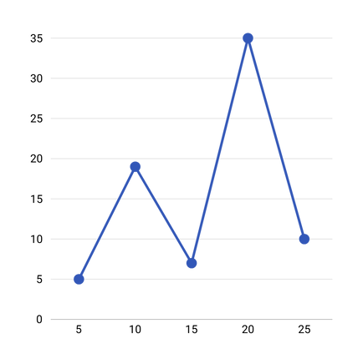
Result Analysis Approaches
1
Visualize influence dynamics
Create graphs of gravity model results for each node over time.
Compare results across different timestamps
2
3
Categorize Nodes
Notes:
After obtaining the gravity models’ results, we are going to analyze how changes the node’s influence over the time.
The first approach is visualization of influence dynamics. We are going to create graphs of gravity model results for each node. X-axis will represent timestamps and y-axis reflects the influence score.
Increasing graphs will represent nodes whose influence grows.
Decreasing graphs, on the contrary, nodes with decreasing influence.
Constant graphs will show that the influence does not change.
And the last type will show that influence has increased and decreased over time.

Slide 17
Result Analysis Approaches
Node | Timestamp 1 | Timestamp 2
1 | 5.36 | 9.63
2 | 8.63 | 8.69
3 | 7.96 | 6.32
4 | 2.36 | 3.1
... | ... | ...
N | 0.85 | 1.02
1
Visualize influence dynamics
Compare results across different timestamps
2
Use statistical methods to measure changes.
3
Categorize Nodes
Notes:
Another approach is comparing results across different timestamps. We can use different statistical methods in order to measure the similarity or change in influence scores between one timestamp and another.
For example, if the correlation between timestamps is close to 0, it indicates changes in the influence scores.

Slide 18

Result Analysis Approaches
1
Visualize influence dynamics
High influence
Compare results across different timestamps
2
Low influence
Medium influence
3
Categorize Nodes
Group by influence level within each timestamp based on their level of influence.
Notes:
One more possible way is to categorize nodes based on their level of influence within each timestamp. Our goal is to find out whether node transition between categories, what means changes in their influence. The optimal number of categories can be chosen during the analysis.

Slide 19
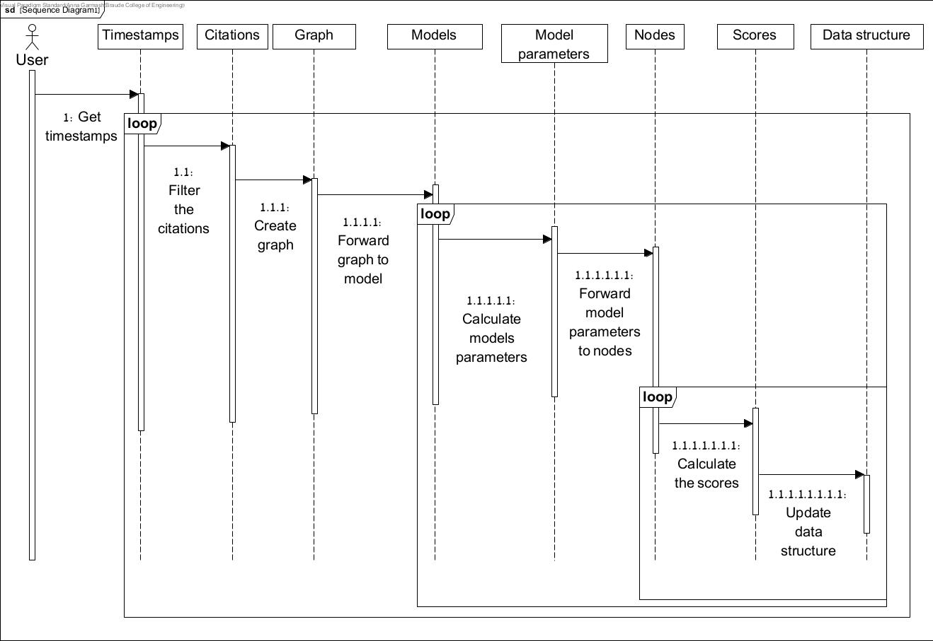
Sequence diagram

Slide 20
Testing Plan
 | Timestamps check | Citation direction | Citation graph building | Gravity Models | Results visualization | Results comparing across different timestamps | Results comparing in nodes categorization
Test | Check if the dataset (citation network) has a publishing date for each document. | Check if first column sites the second column in the dataset. | Check if the amount of the nodes in the graph equals to the number of the rows in the dataset in chosen timestamp. | Check Gravity Models’ score correctness. | Check if there is graph for each node and major lines are constant. Nodes with influence changes are visible. | Check if the statistical methods results are in scope of predefined range. | Check if the number of nodes across the groups are the same as the total number of rows in the dataset.
Input | Dataset | Dataset | Graph and dataset | Gravity Model | 3D score matrix | 3D score matrix | Groups and dataset
Expected output | Each document has dates. | Yes | Yes | Correct scores which capture local and global information. | Graph visualization for each node. | Yes | The number is the same.

Slide 21


Thank You
Notes:
To sum up, today we represented you our final project that deals with identifying influential nodes in citation networks using Gravity Models.
Thank you for your attention.

